Slide 1
Development & Construction of an Autonomous Path-Following Drone
Eduard Scherer
KS im Lee Winterthur

Slide 2
What is a drone?
Notes:
Quadcopter, not military grade→ change of meaning through current conflicts, Does anybody in here know a brand that builds drones?
DJI, geopolitical dependency on china, Monopoly
OS or proprietary software
Data/terms and condition vs. Outdated and sometimes difficult to work with
After the saying of Program or be programmed

Slide 3
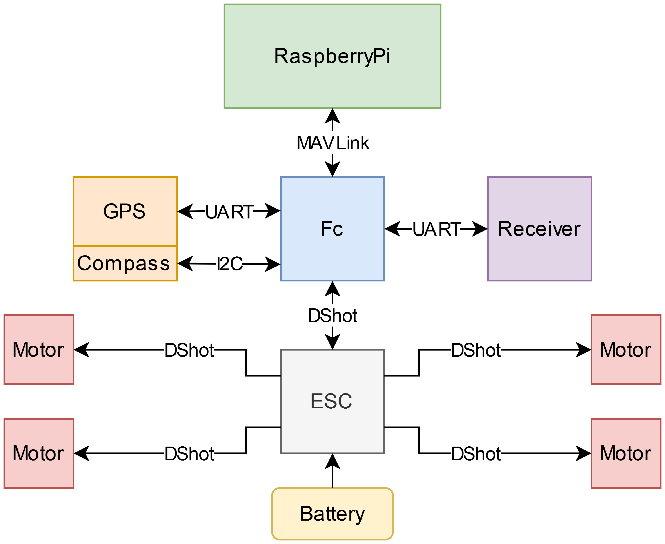
Components
Fc: ArduPilot
ESC: BLHeli_32
Raspberry Pi: DroneKit-Python and custom path-following program
Notes:
Fc: heart of the drone, hosts the flight controller firmware, ArduPilot, connected to the other parts, fc only responsible for data
ESC: controls the motor, upon commands of Fc, connected to batter, sorts out power distribution, too high amperage, all the other just small parts of the initial voltage
Receiver: connection to radio controller (Graphic change?),
GPS and Compass: not needed for some drones, here GPS, not needed if controlled by hand, navigation
RaspberryPi: special hosts dronekitpython, which can do the same thing as the receiver, but without human input, on the drone
On each component is a different software, preinstalled on the esc, needed to install on flight controller, program is on the raspberry pi(intelligence)

Slide 4
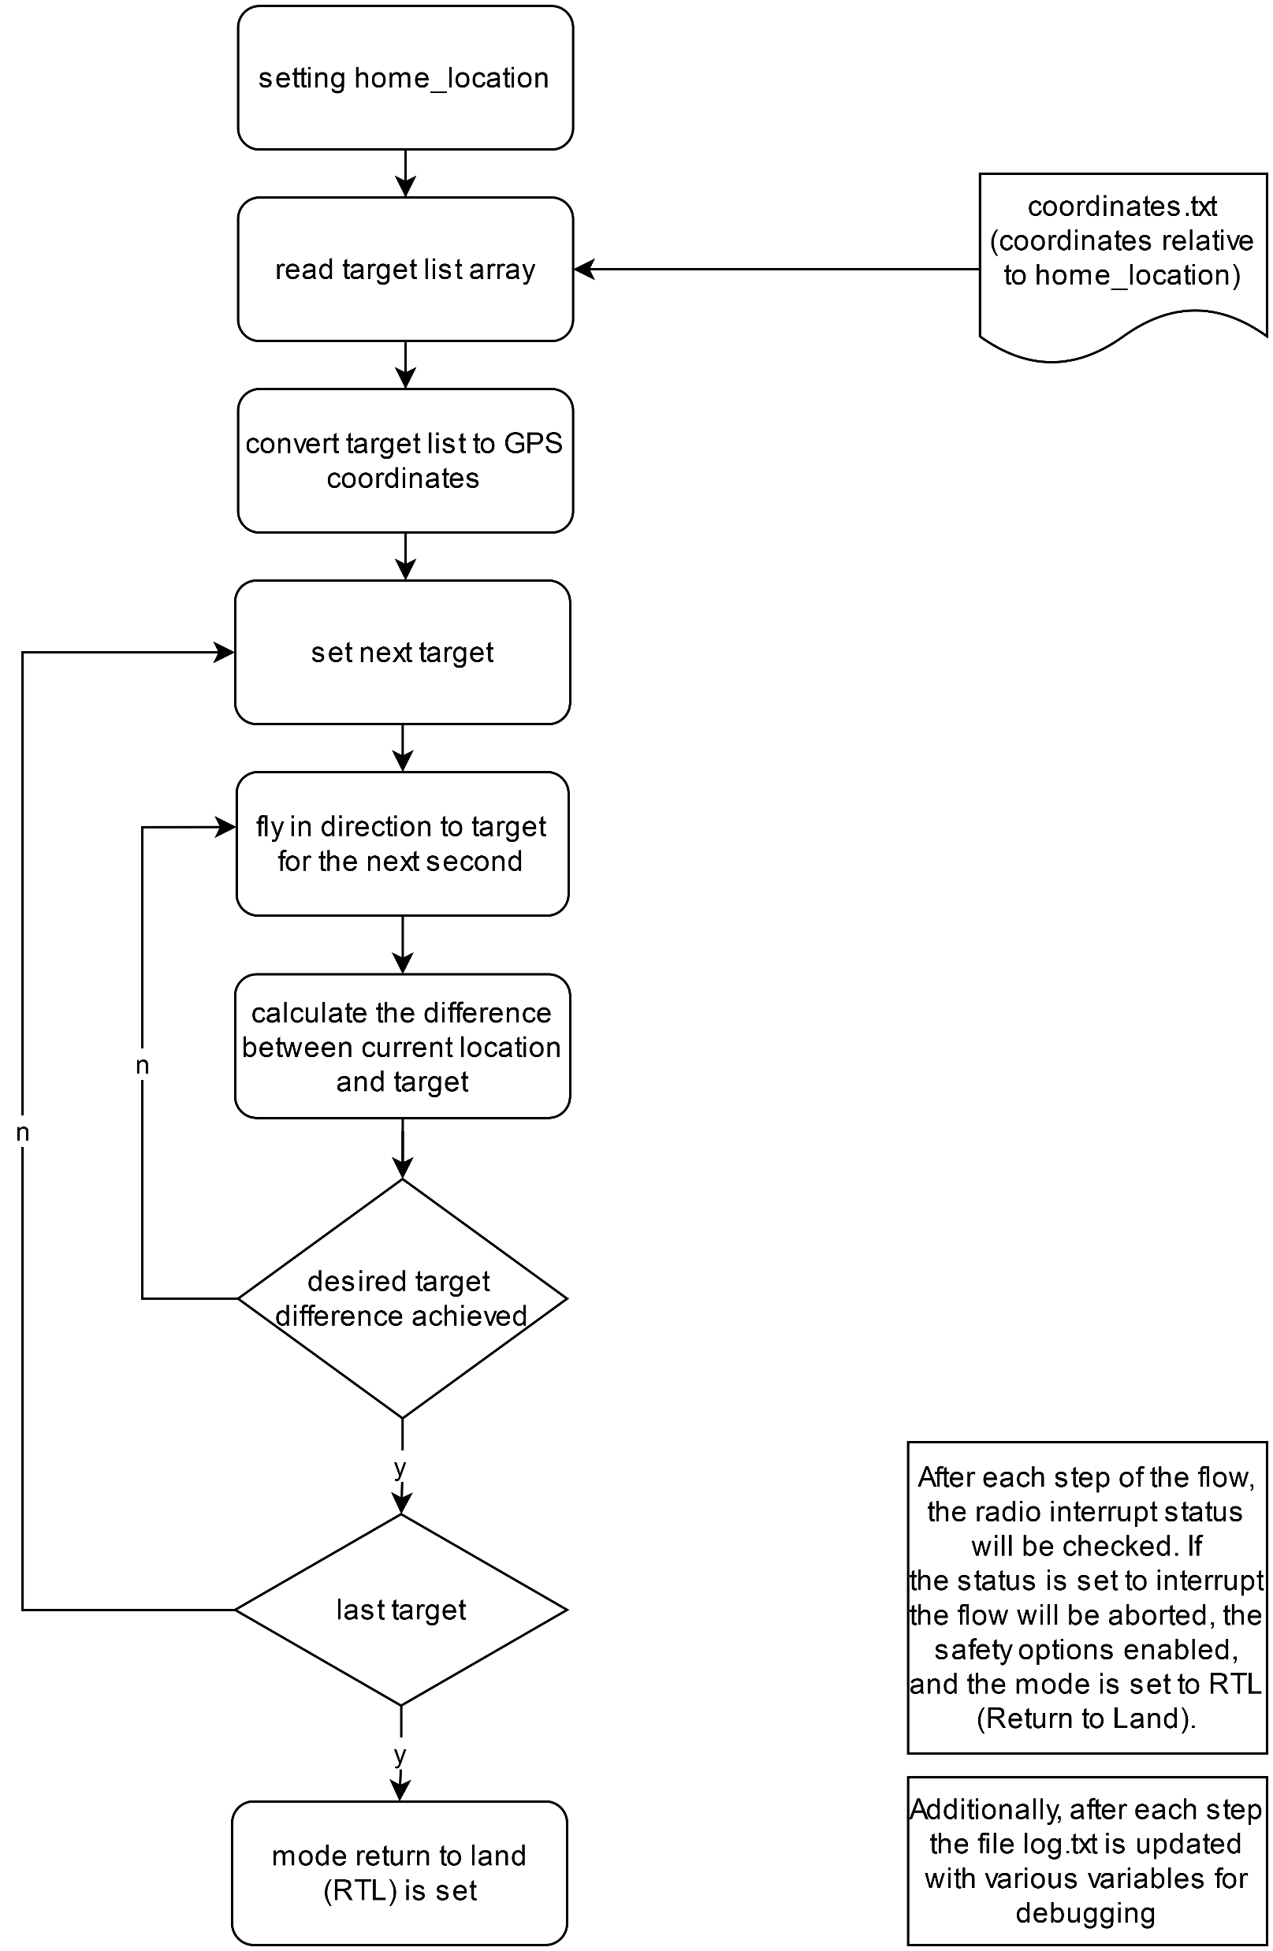
Main Structure of the Path-Following Program
Reading of mission coordinates
Outer loop: path breakdown into individual target coordinates
Inner loop: fly stepwise to next target
Notes:
Software integration
Main program consist mainly reading of mission coordinates and two nested loops (bullet points(inner loop: fly stepwise to next target, outer loop: path breakdown in individual target coordinates))
Python program
Mission Software
Read file→
Essential a target is set
Point can never be reached→ tolerance
Inner loop

Slide 5
Results and Discussion
Component selection
Component integration
3D print of mechanical structure
Software integration
Control with the Raspberry Pi
Flying autonomously worked
Notes:
Instable, maturity not yet reached
Risk that something does not work and fixated date

